Slide 1
Title Introduction to Fuzzy Logic
Subtitle: A Smarter Way to Handle Uncertainty
Name : Raushan CRN : 2221139 URN : 2203751

Slide 2
What is Fuzzy Logic?
Fuzzy
Uncertain – not sure or definite
Vague – not clearly defined
Imprecise – not exact or accurate
Ambiguous – open to more than one interpretation

Slide 3

What is Fuzzy Logic?
Boolean Logic
Boolean logic: It is a branch of mathematics that deals with true and false values, often represented as:
True: means 1
False: means 0
Q. Is it hot? Ans: Yes or NO

Slide 4

What is Fuzzy Logic?
Problem with Boolean Logic
Q. Is it hot? Ans:
Nahi yaar, bilkul bhi nahi.
Boolean Logic {0,1} Yes No
1 0
Bas thodi si garmi lag rahi hai.
Haan yaar, thoda thoda feel ho rahi hai.
Hmm... theek-thaak garmi hai.
Kaafi garmi lag rahi hai.
Bhai, badi garmi hai.
Bhai... jala dene wali garmi hai.

Slide 5
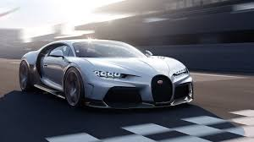
What is Fuzzy Logic?
Fuzzy Logic is a way of thinking that allows machines or systems to handle uncertainty, imprecision, and partial truth.
Fuzzy Logic :(0 ≤ μ(x) ≤ 1)
Membership Function (μ)
Membership Function (μ)
39.8
40.1
40.2
1
1
30
30.9
0
0
Slow Acc
40
Fast Break
80
Speed of car
Slow
40
Fast
80
Speed of car

Slide 6
What is Fuzzy Logic?
Check the degree of fastness
0 , if speed (x) ≤ 40
Speed | Degree of fastness
42 | 2/10 = 0.2
44 | 4/10 = 0.4
46 | 6/10 = 0.6
48 | 8/10 = 0.8
speed(x) – 40 , if 40 < speed(x) < 50
μF​(x)=
10
1 , if speed (x) ≥ 50
₁
₀
Fuzzy Logic : (0 ≤ μ(x) ≤ 1)
₈₀
_{Slow}
₄₀
₅₀
_{Fast}
_{Speed of car}

Slide 7
What is Fuzzy Logic?
Solution with fuzzy Logic
Q. Is it hot? Ans:
Is It hot | Degree/Intensity
Nahi yaar, bilkul bhi nahi. | 0.0
Bas thodi si garmi lag rahi hai. | 0.2
Haan yaar, thoda thoda feel ho rahi hai. | 0.4
Hmm... theek-thaak garmi hai. | 0.5
Kaafi garmi lag rahi hai. | 0.7
Bhai, badi garmi hai. | 0.8
Bhai... jala dene wali garmi hai. | 1.0

Slide 8
History of Fuzzy Logic
1965 – Birth of Fuzzy Logic Lotfi A. Zadeh introduced Fuzzy Sets to model vagueness in human reasoning.
1970s – Theory Development Zadeh expanded fuzzy sets into a logic system to handle imprecise data.
1980s – Industrial Adoption
Japan led real-world applications (e.g., Sendai Subway, consumer electronics).
Improved automation and control systems.
1990s – Global Expansion
Widely used in AI, automotive, appliances, and control systems.
Gained recognition in the West.
Present – Hybrid Systems
Integrated with AI, Neural Networks, and IoT.
Valuable in applications needing human-like reasoning.

Slide 9
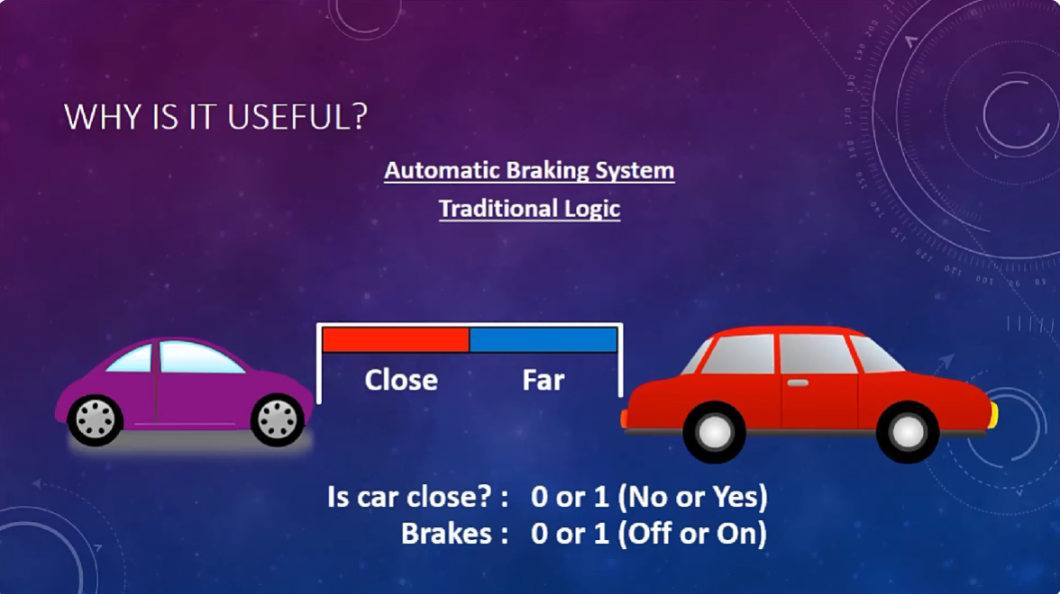

Example:

Slide 10
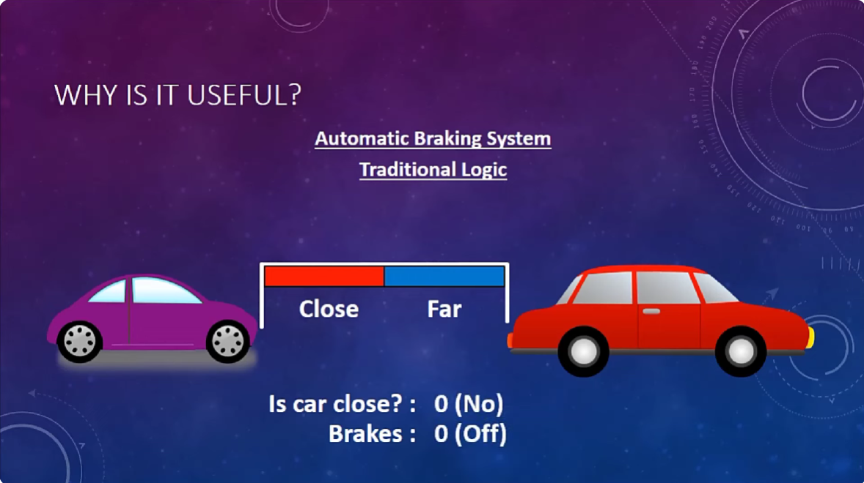


Slide 11
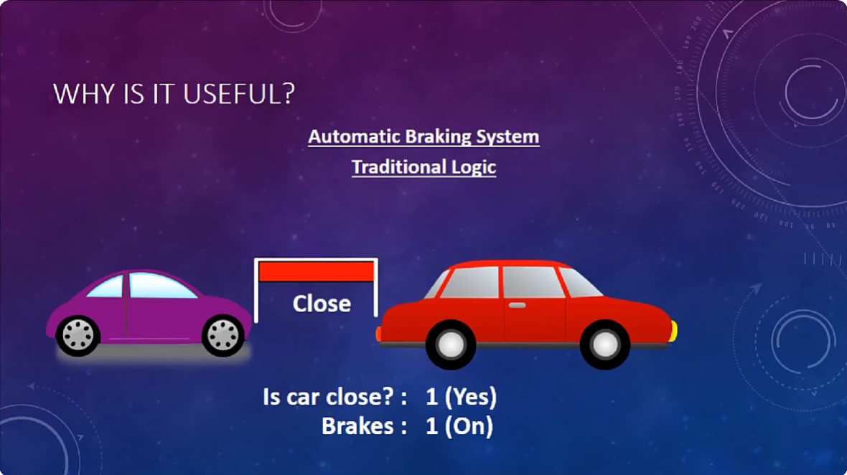

Slide 12
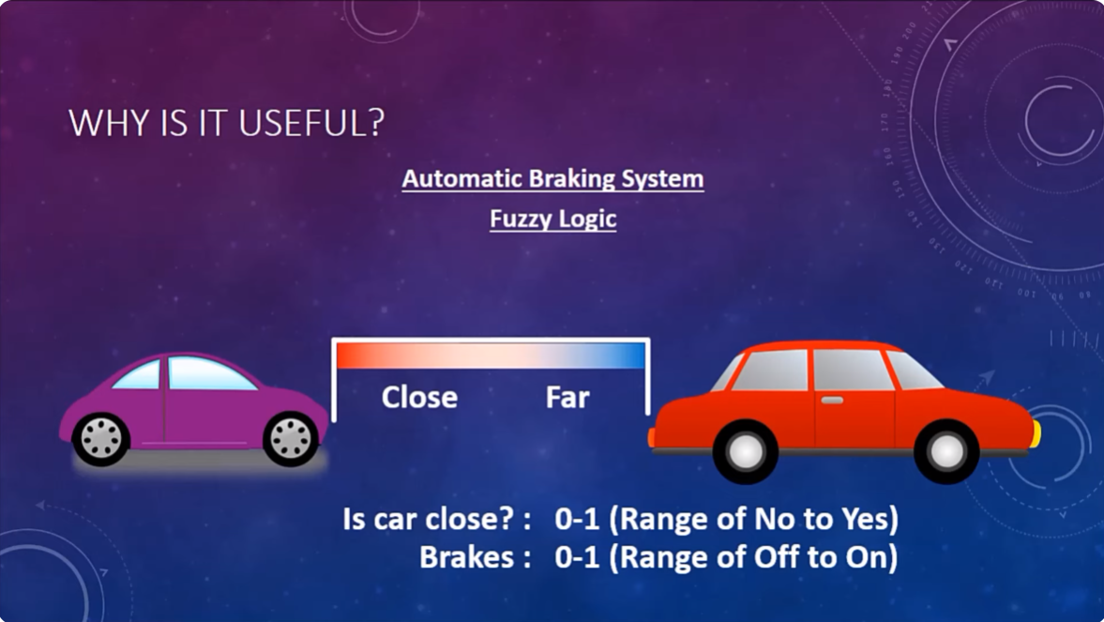

Slide 13
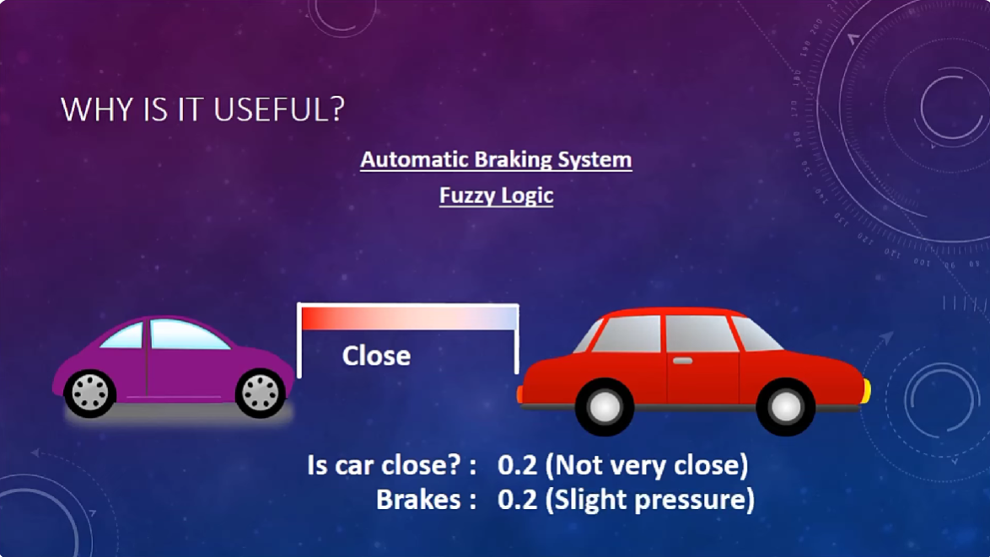

Slide 14
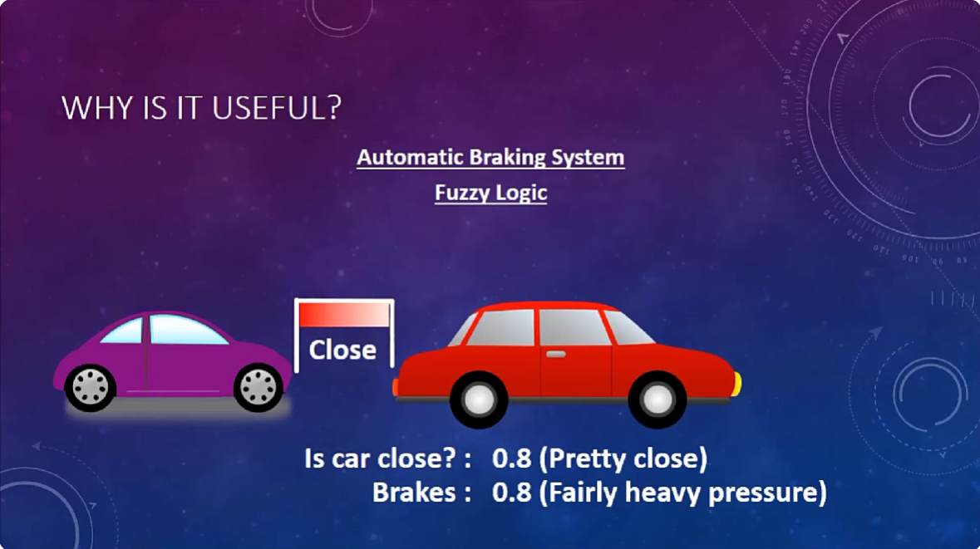

Slide 15
Why Use Fuzzy Logic?
Handles Uncertainty and Vagueness Fuzzy logic can process imprecise, vague, or incomplete information effectively.
Mimics Human Reasoning It models the way humans make decisions using linguistic terms like "almost", "somewhat", "very".
Simple Rule-Based System Uses IF-THEN rules, which are easy to create and understand, even for complex systems.
Cost-Effective Implementation Requires less processing power compared to complex AI systems; ideal for embedded systems.
Improves Performance in Complex Systems Enhances control systems where conventional logic fails, especially in nonlinear systems.

Slide 16
Applications of Fuzzy Logic
Automotive Systems Applied in speed control, braking systems, and traffic control for smarter and safer transportation.
Aerospace Used for altitude control of spacecraft and satellites, ensuring stable flight dynamics under uncertain conditions.
Chemical Industry Controls critical processes like pH balance, drying, and chemical distillation with high accuracy under variable conditions.
Modern Control Systems Powers expert systems, automation, and intelligent controllers in industrial and consumer electronics.
Fuzzy Logic + Neural Networks Combines with Neural Networks to make intelligent decisions — aggregating data into fuzzy sets to form partial truths, mimicking human logic at high speed.

Slide 17
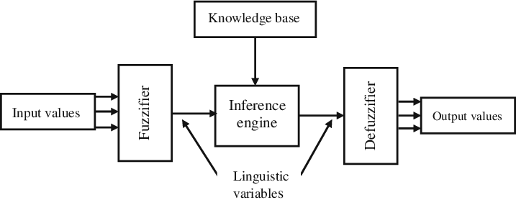

Architecture of Fuzzy Logic
It’s Architecture contains four parts : 1. Rule Base 2. Fuzzifier 3. Inference Engine 4. Defuzzifier
Rule Base
1. Crisp Input : The car's speed is 75 km/h and "the road is slightly wet. 2. Fuzzifier: It is used to convert crisp inputs to fuzzy sets. Example: 75 km/h → "Fast" Slightly wet road → "Slightly Slippery"

Slide 18
Architecture of Fuzzy Logic
3. Rule Base: It contains the set of rules and the IF-THEN conditions provided by the experts. Example:
IF speed is fast AND road is slippery → THEN slow down a lot.
IF speed is slow AND road is dry → THEN no need to slow down.
4. Inference Engine: It thinks and decides based on rules and the fuzzy inputs. Example: Speed is "fast" and road is "slightly slippery" → Decision: "Reduce speed moderately.“ 5. Defuzzifier: It is used to convert the fuzzy sets into a crisp output. Example: Car's speed is reduced from 75 km/h to 55 km/h.

Slide 19
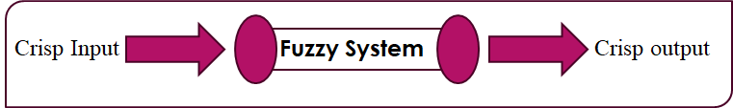
Fuzzification and Defuzzification
Fuzzification:Fuzzification means converting real-world crisp input values into fuzzy values.
Defuzzification:Defuzzification means converting fuzzy output values back into crisp values.
Fuzzifier
Defuzzifier

Slide 20
Fuzzy Set
Traditional Set: A traditional set is a collection of objects where each element either completely belongs to the set or does not belong at all.
Membership is binary — only 0 (No) or 1 (Yes).
No partial belonging is allowed.
Fuzzy Set: A fuzzy set F on a given universe of discourse U is defined as a collection of ordered pairs (x, μF(x)), where x ∈ to U and for all x ∈ U, 0 ≤ μF(x) ≤1.
F = {(x, μF​(x)) ∣ x ∈ U, 0 ≤ μF​(x) ≤ 1}
F → Fuzzy set name x → Member x∈U → Element x belongs to U μF​(x) → Membership function 0≤μF​(x)≤1 → Degree of membership lies between 0 and 1

Slide 21
Example of Fuzzy Set
Sr.No | Family members | Age | Gender
1 | Grand Father | 72 | M
2 | Grand Mother | 63 | F
3 | Dad | 41 | M
4 | Mom | 38 | F
5 | Doughter | 15 | F
6 | Son | 13 | M
7 | Aunt | 52 | F
U={Grand Father, Grand Mother, Dad, Mom, Daughter, Son, Aunt}
M={Grand Father, Dad, Son}
F={Grand Mother, Mom, Daughter, Aunt}
Set of Senior Members ???
Fuzzy Set
0 , if Age(x) ≤ 30
μ(x)=
Age(x) – 30 , if 30 < Age(x) < 70
40
1 , if Age(x) ≥ 70

Slide 22
Example of Fuzzy Set
U={Grand Father, Grand Mother, Dad, Mom, Daughter, Son, Aunt}
M={Grand Father, Dad, Son}
F={Grand Mother, Mom, Daughter, Aunt}
Sr.No | Family members | Age | Gender | Degree/Intensity
1 | Grand Father | 72 | M | 1
2 | Grand Mother | 63 | F | 0.825
3 | Dad | 41 | M | 0.275
4 | Mom | 38 | F | 0.2
5 | Doughter | 15 | F | 0
6 | Son | 13 | M | 0
7 | Aunt | 52 | F | 0.55
Set of Senior Member ???
Fuzzy Set
0 , if Age(x) ≤ 30
Age(x) – 30 , if 30 < Age(x) < 70
40
1 , if Age (x) ≥ 70
Senior Members={(Grand Father,1),(Grand Mother,0.825),(Dad,0.275),(Mom,0.2),(Aunt,0.55)}

Slide 23
We have learned
Fuzzy Logic
Application of Fuzzy Logic
Boolean Logic
Architecture of Fuzzy Logic
History of Fuzzy Logic
Fuzzifier and Defuzzifier
Example of Fuzzy Logic
Fuzzification and Defuzzification
Why use Fuzzy Logic
Fuzzy Set and Example

Slide 24
Thank You
Name : Raushan CRN : 2221139 URN : 2203751

